Slide 1
Foil Art

Slide 2
Relief and engraving
Relief
Counter Relief
from the Latin verb relevo, to raise
To create a sculpture in relief is to give the impression that the sculpted material has been raised above the background
Intaglio, Italian term, engraving
where the form is cut into the field or background rather than rising from it

Slide 3
High and Low Relief
Lorenzo Ghiberti's cast gilt-bronze "Gates of Paradise" at the Florence Baptistery in Florence, Italy, combines high-relief main figures with backgrounds mostly in low relief

Slide 4
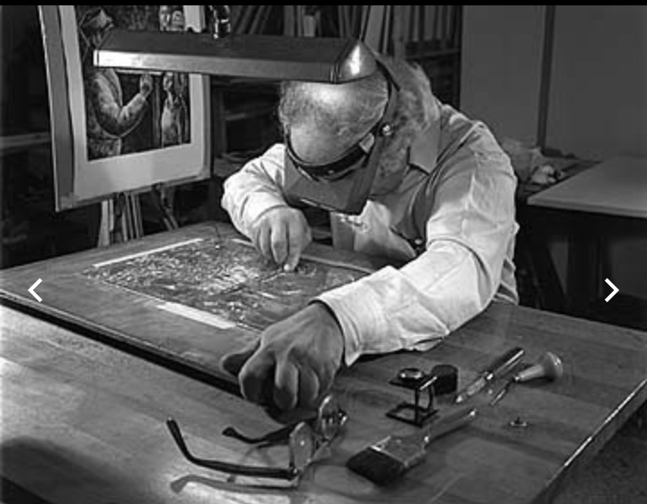
Counter Relief or engraving
Chaim Goldberg creating a hand-engraved image on a copper plate.

Slide 5
Options for our project
Well thought out relief design

Slide 6
Color
Adding color with sharpies

Slide 7
Creating texture

Slide 8
Actual and implied texture
Create a pattern on your foil to make relief or counter relief and then continue that pattern on paper with out the relief

Slide 9
Example of a finished class project

